Slide 1
Channel Estimation
Ola Fathy & Aya Khaled
15E0100@eng.asu.eg
@eng.asu.eg

Slide 2
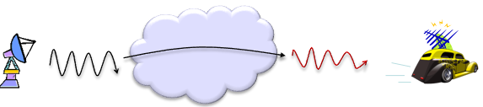
Why Channel estimation?
to remove the distortion and noise applied by the channel

Slide 3
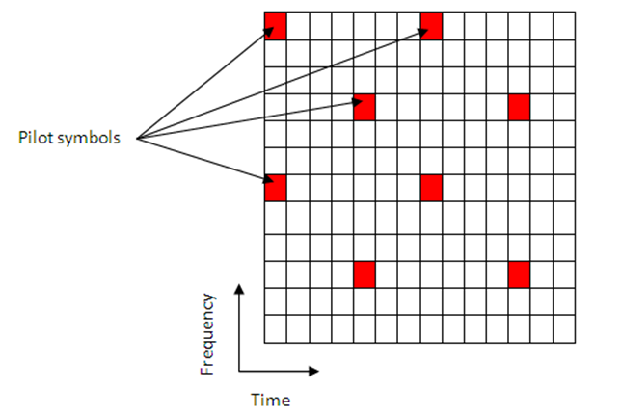
Channel Estimation Overview

Slide 4
Channel Estimation Block Diagram
GetPilotEstimates
PilotAverage
Interpoliation
LSE
TestEVM
Linear
MMSE
Userdefined

Slide 5

Pilot Estimation Techniques
Least square error (LSE)
calculate channel response at pilot symbols
Minimum mean square error (MMSE)
This method has better performance than LS,
but it is more complex.

Slide 6
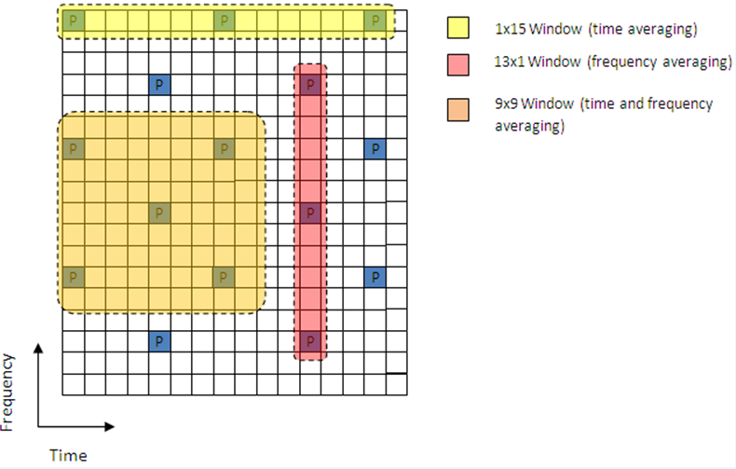
Averaging Techniques
TestEVM (Error vector magnitude)
User defined

Slide 7
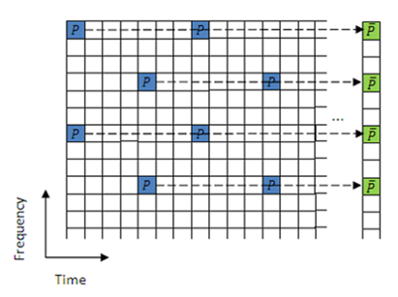
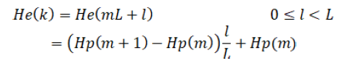
Interpolation

Slide 8
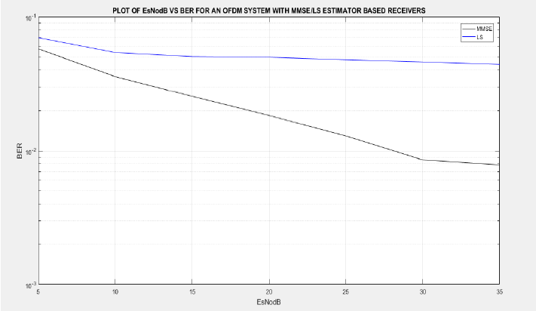

Slide 9
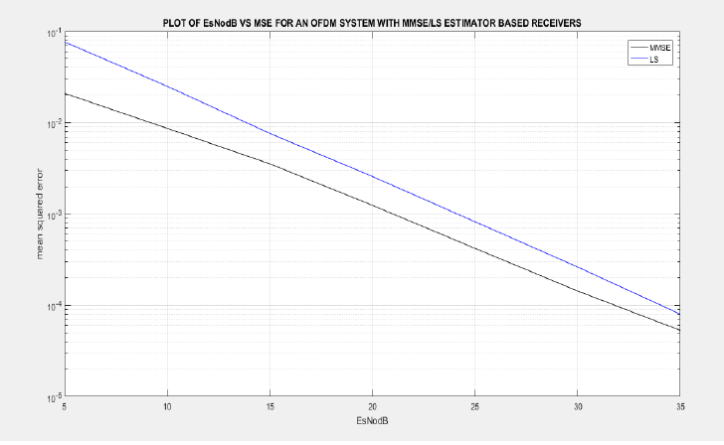

Slide 10
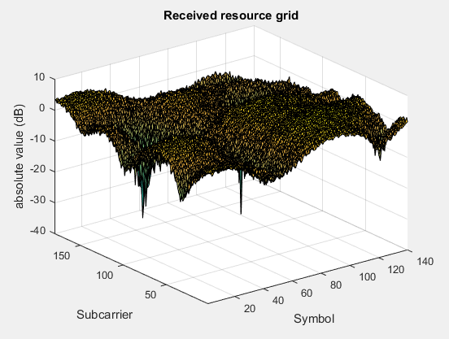

Slide 11
